Slide 1
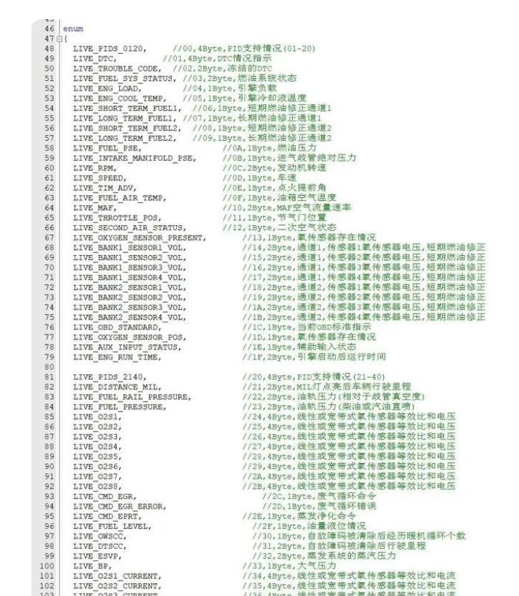
WEEK15 LAB
在实际编程中，有些数据的取值往往是有限的，只能是非常少量的整数，并且最好为每个值都取一个名字，以方便在后续代码中使用，比如一个星期只有七天，一年只有十二个月，一个班每周有六门课程等。 C语言提供了一种枚举（Enum）类型，用于给整数起一个“别名”，方便在编程的过程直观地用名字来表示数字。
In actual programming, the value of some data is often limited, can only be a very small number of integers, and it is best to give each value a name, in order to facilitate use in subsequent code, such as only seven days a week, only twelve months a year, a class has six courses a week, etc. The C language provides an Enum type, which is used to give an "alias" to integers, so that numbers can be intuitively represented by names during programming
注意：枚举的作用仅仅是用“符号名”替换整数，当你有大量的固定数据，你很难去记住每一个整数代表的是哪一种情况，这时便可以使用枚举，直接用“符号名”代替整数进行编程。
Note: The role of enumeration is only to replace integers with "symbol names", when you have a lot of fixed data, it is difficult to remember what each integer represents, then you can use enumeration, directly with "symbol names" instead of integer programming.

Slide 2
以每周七天为例，我们为一周的7天分别指定一个名字，并直接使用枚举变量来代替整数进行编程。
In the case of the seven days of the week, we give each of the seven days a name and program directly with enumeration variables instead of integers.
#include <stdio.h>
int main(){
enum week{ Mon = 1, Tues, Wed, Thurs, Fri, Sat, Sun };
int day;
scanf("%d", &day);
switch(day){
case Mon: puts("Monday"); break;
case Tues: puts("Tuesday"); break;
case Wed: puts("Wednesday"); break;
case Thurs: puts("Thursday"); break;
case Fri: puts("Friday"); break;
case Sat: puts("Saturday"); break;
case Sun: puts("Sunday"); break;
default: puts("Error!");
}
return 0;
}

Slide 3
1. 尝试使用枚举类型和sprintf函数完成下面的功能：
编写程序，让用户输入月/日/年，输出月的名称，日，年。
Try using the enumeration type and the sprintf function to do the following: Write a program that lets the user enter the month/day/year and output the name of the month, day, and year.
input date: 1/20/2023
Output: January 20, 2023
2. 编写两个函数，分别求两个数的最大公约数和最小公倍数。
Write two functions to find the greatest common divisor and the least common multiple of two numbers respectively.
3. 编写函数，分别使用不同的排序方法（冒泡、选择、插入）对一个数组进行排序并输出。
Write functions to sort and output an array using different sorting methods (bubble, select, insert).
4. 递归地求解斐波那契数列的第n个数。
Recursively solve for the n^{th} number in the Fibonacci sequence.
5. 编写一个函数，判断输入的年份是否为闰年，判断闰年的标准是：能整除4并且不能整除100，或者能整除400。编写主函数，判断从2000年到2050年之间哪些年份是闰年，并输出到文件里。
Write a function to determine whether the input year is a leap year. The criteria for determining leap years are: can divide 4 and not divide 100, or can divide 400. Write the main function that determines which years between 2000 and 2050 are leap years and output it to the file.

